Slide 1


COMPLAINT REDRESSAL SYSTEM
RLL – TEAM PROJECT
GROUP NO:- 2
Notes:
We designed this template so that each member of the project team has a set of slides with its own theme. Members, here’s how you add a new slide to just your set:
Mark where you want to add the slide: Select an existing one in the Thumbnails pane, click the New Slide button, then choose a layout. The new slide gets the same theme as the other slides in your set.
Careful! Don’t annoy your fellow presenters by accidentally changing their themes. That can happen if you choose a different theme from the Design tab, which changes all of the slides in the presentation to that look.

Slide 2
TEAM MEMBERS
ID​​ | Name​​
2498897​​ | Parth Satish Palkar (Team Lead)​​
2498365​​ | Puppala Amal Sai (Backend Lead)​​
2498305​​ | Dasari Sravankumar (Frontend Lead)​​
2498690​​ | MOTHKURY VISHNU VARDHAN​​
2499295​​ | SAGARLA NAVALA​​
2498561​​ | Chithram Vennela​​
2498656​​ | Guggulothu Karthik​​
2498956​​ | Konduru Charishma​​
2498069​​ | Sampangai Kalyan​​
2498070​​ | Chintada Sai Praveen​​

Slide 3
INDEX
Introduction
Project Scope
Tools & Technologies
ER Diagram
Schema
Modules
Output
Conclusion

Slide 4
INTRODUCTION
The main objective of this Complaint Redressal system is to focus on the issues related to customer.
Redressal approach through tickets and complaint forms.
The objective of the complaints redressal system is to make complaints easier to coordinate, monitor, track and resolve, and to provide company with an effective tool to identify and target problem areas, monitor complaints handling performance and make business improvements.
Customer complaints systems improve customers' experiences of dealing with your organisation and reduce the risk of reputational damage from a customer who does not believe they have been dealt with fairly.
Complaint redressal is a set of procedures used in organisations to address complaints and resolve disputes.

Slide 5
PROJECT SCOPE
Receive daily complain from customer.
Allow customer to registered and obtain username and password to login into the system and lodge in their complain and view previous complain.
This Complaint Redressal System can reduce the efforts of human power.
This application automates manual tasks by managing all records.
It is a web-based application for maintaining records.

Slide 6
TECHNOLOGIES
FRONT END : Angular
BACK END : My SQL, Hibernate
SERVER SIDE : Spring boot
SERVER : Apache Tomcat
TESTING : Postman

Slide 7
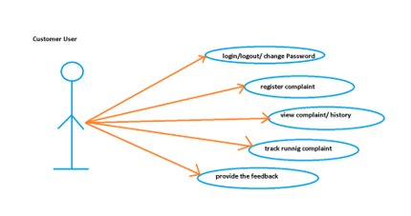
ER DIAGRAM:- USECASE OF CUSTOMER

Slide 8
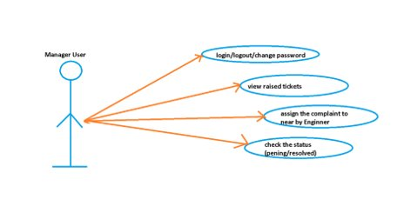
USECASE OF MANAGER

Slide 9
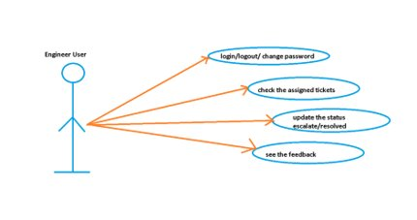
USECASE OF ENGINEER

Slide 10
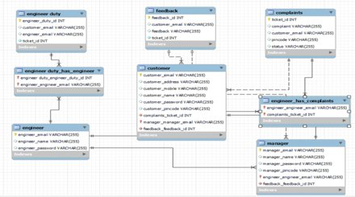
SCHEMA

Slide 11
MODULES
Admin
Customer
Manager
Engineer

Slide 12
ADMIN
Admin user is the super user of the system.
The admin user creates other categories of user like customer, manager, and engineers.
The admin user has the privilege to create, update and delete the records through the web interface and can access the entire system

Slide 13
CUSTOMER
ENABLES THE CUSTOMERS TO LOGIN TO THE PORTAL TO RAISE AND TRACK COMPLAINTS RELATED TO THE SERVICES AVAILED BY THEM.
VIEW COMPLAINTS.
TRACKING THE COMPLAINT.
CUSTOMERS SHOULD PROVIDE THE FOLLOWING MINIMAL DETAILS SUCH AS NAME, ADDRESS (WITH PIN CODE), TELEPHONE / MOBILE NUMBER, TYPE OF PROBLEM (CANNOT MAKE A CALL, BUT RECEIVE A CALL OR CAN MAKE CALLS, BUT CANNOT RECEIVE CALLS, OR NEITHER MAKE NOR RECEIVE CALLS).

Slide 14
MANAGER
ENABLES THE MANAGER TO LOGIN, VIEW THE COMPLAINTS RAISED BY THE CUSTOMERS AND ASSIGN THE TICKET TO THE ENGINEERS BASED ON THE PIN CODE.
PICK THE TICKETS FROM THE ACTIVE TICKET LIST AND ASSIGN THEM TO THE ENGINEERS BASED ON THE PIN CODE OF THE CUSTOMER .
THERE SHOULD BE DIFFERENT MANAGERS TO TAKE CARE OF DIFFERENT PIN CODES.

Slide 15
Engineer
Enables the engineers to pick up the tickets, work on them, enter the status of the task. They can also re-assign it to the Field Workers if they cannot resolve it from the data center.
Login and view all the tickets assigned to him/her.

Slide 16
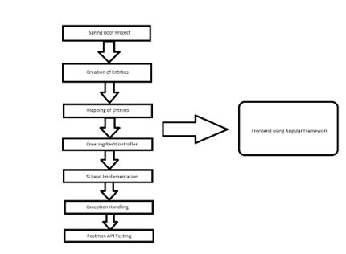
FLOW DIAGRAM

Slide 17
SYSTEM OVERVIEW
THE “COMPLAINT REDRESSAL SYSTEM” SHOULD SUPPORT BASIC FUNCTIONALITIES FOR ALL BELOW LISTED USERS.
ADMIN
CUSTOMER
MANAGER
ENGINEER
AUTHENTICATION & AUTHORIZATION:-
AUTHENTICATION: ANY END-USER SHOULD BE AUTHENTICATED USING A UNIQUE USER-ID AND PASSWORD.
AUTHORIZATION: THE OPERATIONS SUPPORTED AND ALLOWED WOULD BE BASED ON THE USER TYPE.

Slide 18
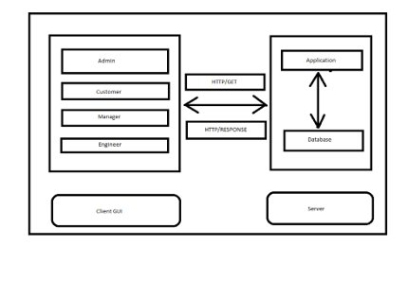
FUNCTIONAL FLOW

Slide 19
ANNOTATIONS
REQUEST MAPPING
AUTO WIRED
POST MAPPING
GET MAPPING
DELETE MAPPING
PUT MAPPING

Slide 20
FUNCTIONAL SPECIFICATIONS
LOGIN SCREEN:-
THE LOGIN SCREEN WILL HAVE THE USERNAME AND PASSWORD FIELDS.
REDIRECT BACK TO SAME LOGIN SCREEN IF USERNAME & PASSWORD ARE NOT MATCHING.
THE USERNAMES AND PASSWORDS AND ROLES ARE STORED IN THE USER TABLE.
THE SYSTEM SHOULD SHOW THOSE SCREENS THAT ARE ALLOWED FOR EACH CATEGORY OF USERS.

Slide 21
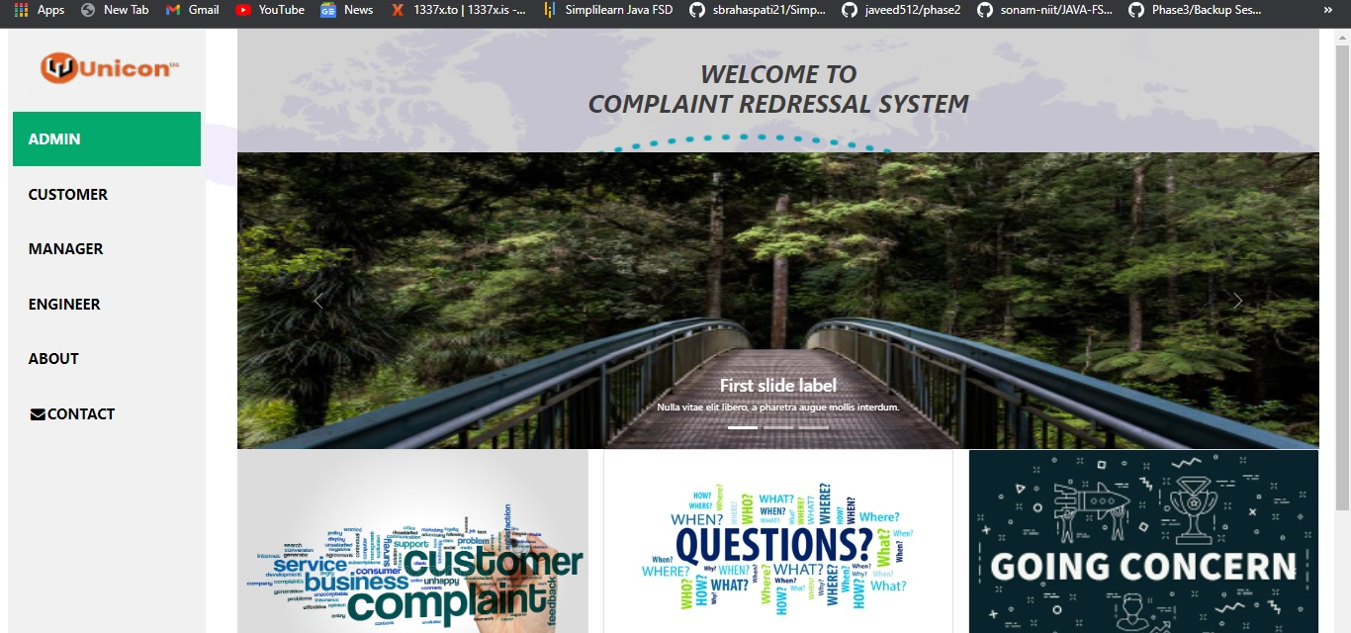
WELCOME PAGE

Slide 22
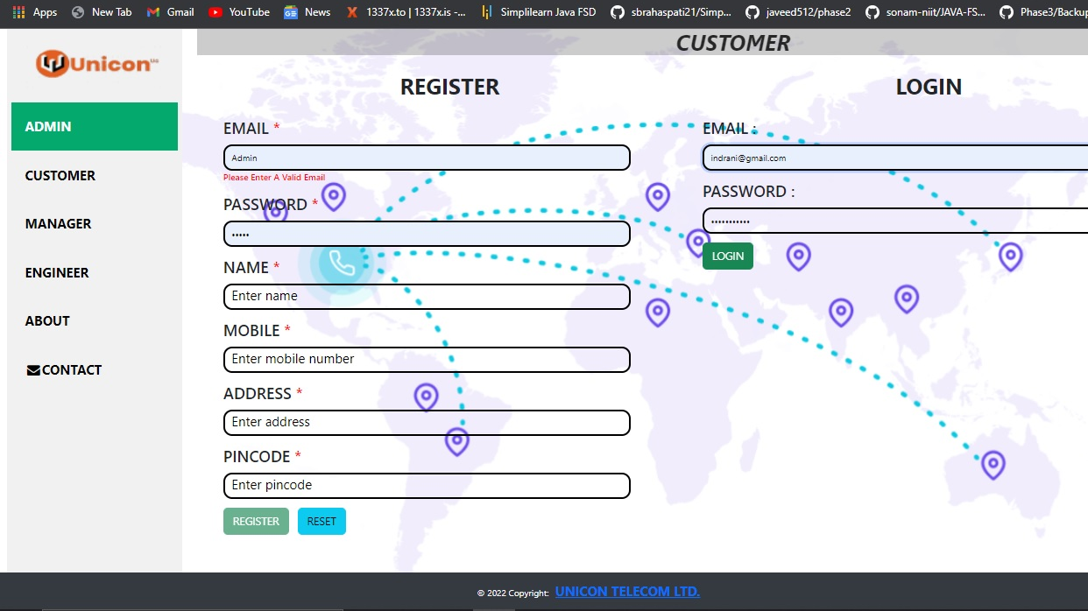
CUSTOMER PAGE

Slide 23
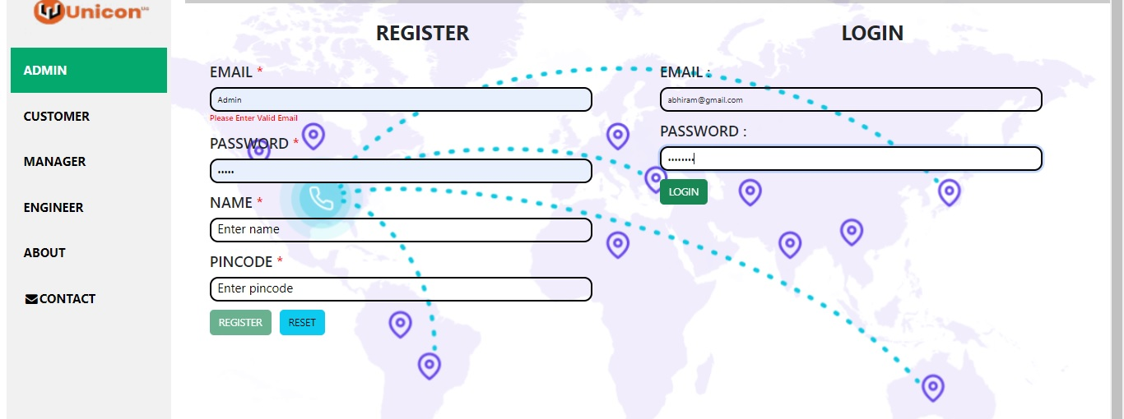
MANAGER PAGE

Slide 24
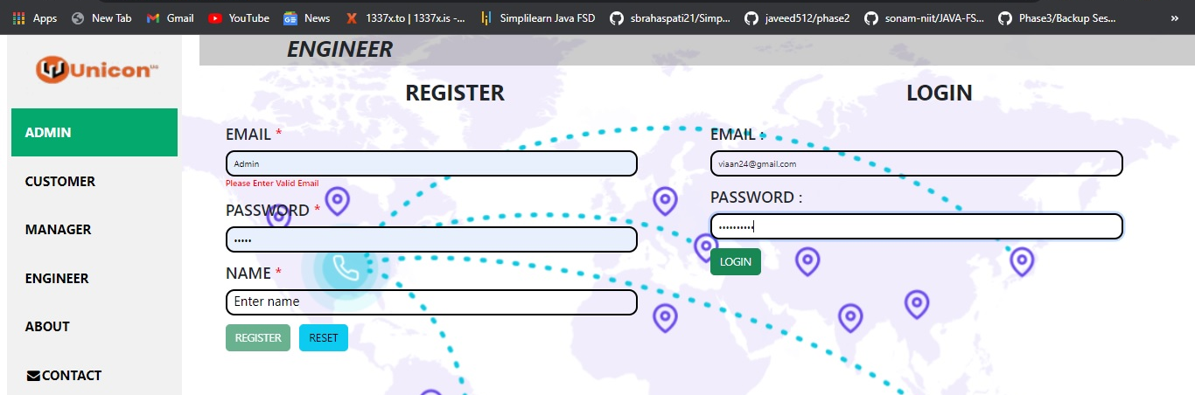
ENGINEER PAGE

Slide 25
CONCLUSION
THIS APPLICATION AUTOMATES MANUAL TASKS BY MANAGING ALL RECORDS OF CUSTOMER, MANAGER AND ENGINEER.
THIS COMPLAINT REDRESSAL SYSTEM CAN REDUCE THE EFFORTS OF HUMAN POWER.
THIS HELPS TO INCREASE BUSINESS.

Slide 26
Thank You

